Slide 1
Channel Access
Kay Kasemir based on material by
Bob Dalesio (then LANL)
Ned Arnold (APS)
Ken Evans (APS)
Feb. 2022

Slide 2
Channel Access: The EPICS Network Protocol
Read and write Process Variables over the network.
To many, CA is EPICS.
  Especially if your background is w/ systems
  that have no IOC database.
  "Integrate into EPICS" can mean:
  Talk CA on the network.

Slide 3
Advantages over similar Control System/IoT Protocols
”Zero config” for small setups, yet scales to large networks
Distributed, no central “Name Server” or “Broker” bottleneck
Read/write/subscribe (‘get’, ‘put’, ‘monitor’)
  Monitor sends initial value
  ‘put-callback’ option for assured completion
Data types that combine value with timestamp, units, status
Since ca. 1990.
Upcoming alternative: PV Access

Slide 4
Consider a ‘news’ website…
People create web pages with news
http:// serves them
  Doesn’t mean you can list all the people,
  or get the color of their socks
  People might change
  Some pages are created by programs, they don’t wear socks!
Records on IOCs provide data
Channel Access serves them
  Doesn’t mean you can list all records
  IOCs might change
  Some channels are provided by python, LabVIEW, …,
  there are no records!

Slide 5
Keep in mind
The protocol http:// is different from the people who create web sites
The Channel Access (and PV Access) protocol is different from the IOCs and records
This ‘decoupling’ has proven essential but is often forgotten !

Slide 6
What is a Process Variable?
Good question!
"A named piece of data with attributes”
Consider this record:
record(calc, "t1:calcExample")
{
field(DESC, "Sawtooth Ramp")
field(SCAN, "1 second")
field(CALC, "(A<10)?(A+1):0")
field(INPA, "t1:calcExample.VAL")
}

Slide 7
What is a PV, given that record?
"t1:calcExample"
  PV for the current value of the record.
  Number 0…10, changes each second.
"t1:calcExample.DESC"
  PV for the DESC (description) field of the record.
  String "Sawtooth Ramp", static.
"t1:calcExample.VAL"
  Same as "t1:calcExample".
“t1:calcExample.SCAN”
  “1 second”, type enumerated, static.
Pretty much every field of a record can be a PV:
  "{record name}.{field name}"
  ".VAL" is implied when omitting field

Slide 8
'caget', 'caput’
'caget' command-line tool:
  > caget t1:calcExample
  t1:calcExample 6
  > caget t1:calcExample.VAL
  t1:calcExample.VAL 9
  > caget t1:calcExample.DESC
  t1:calcExample.DESC Sawtooth Ramp
'caput' allows writing:
  > caput t1:calcExample.DESC "Howdy"
  Old : t1:calcExample.DESC Sawtooth Ramp
  New : t1:calcExample.DESC Howdy

Slide 9
'camonitor'
'camonitor' monitors value changes:
  > camonitor t1:calcExample
  t1:calcExample 2006-10-06 13:26:03.332756 6
  t1:calcExample 2006-10-06 13:26:04.332809 7
  t1:calcExample 2006-10-06 13:26:05.332866 8
  t1:calcExample 2006-10-06 13:26:06.332928 9
  t1:calcExample 2006-10-06 13:26:07.332981 10
  t1:calcExample 2006-10-06 13:26:08.333034 0
  t1:calcExample 2006-10-06 13:26:09.333097 1
  t1:calcExample 2006-10-06 13:26:10.333143 2
  … plus one more each second…
  … press Ctrl-C to stop …
  > camonitor t1:calcExample.DESC
  t1:calcExample.DESC 2006-10-06 13:29:12.442257 Howdy
  … and then nothing …
AKA publish and subscribe.

Slide 10
How Clients find Channels
Wants to read "PS1:Voltage"
Client
Client
Client
Client
Client
Client
Channel Access
IOC
IOC
IOC
IOC
Meter
Power Supply
Camera
Has PV "PS1:Voltage"

Slide 11
Internet 101
The Internet Protocol (IP) consists of UDP and TCP
  .. and lower level ICMP, ARP, …
User Datagram Protocol (UDP)
  Sends a network packet
    from one port on one computer
    to one or more ports on one or more other computers.
    ..with one or more listeners on the target port
  Fast!
  Checksum: If the packet arrives, it's OK.
  Not reliable: Packets get lost, arrive out-of-order, arrive more than once.
Transmission Control Protocol (TCP)
  Sends a stream of bytes from one port on one computer to another port on another computer, with exactly one listener on the target port
  Reliable: Bytes arrive at the receiver in the correct order.
    Basically, adds serial numbers to UDP packets,
    requesting repeats for missing packages.
  Slower, and message boundaries get lost:
    "Hello Fred!" might arrive as "Hel" <pause> "lo F" <pause> "red!"

Slide 12
Search and Connect Procedure
Client
Client
Client
Client
Client
Client
3. TCP Connection
Let’s talk !
2. UDP Reply
I have it !
UDP Broadcast Sequence
Who has it ?
Server
IOC
IOC
Check
Check
IOC
IOC
Check
Check
Meter
Power Supply
Camera

Slide 13
Search Request
A search request consists of a sequence of UDP packets
  Per default: Broadcast to the local subnet.
    Basically plug-and-play when you get started.
  Or to IP addresses listed in EPICS_CA_ADDR_LIST
    Routers do not forward broadcasts!
    You have to add 'other' subnets or specific IOCs off the local subnet to that environment variable!
  Starts with a small interval (0.1 s)
    Doubles each time, until reaching 5 minute intervals.
    Stops after when it gets a response
    Wakes again on "beacon anomaly" (details follow later)
CA Servers check each search packet
Usually connects on the first packet or the first few
  But non-existent PVs cause a lot of traffic
  Try to eliminate them
Searches
Time

Slide 14
Important Environment Variables
EPICS_CA_ADDR_LIST
  Determines where to search
  Is a list (separated by spaces)
    “123.45.1.255 123.45.2.14 123.45.2.108”
  Default is broadcast addresses of all interfaces on the host
    Works when servers are on same subnet as Clients
  Broadcast address
    Goes to all servers on a subnet
    Example: 123.45.1.255
    Use `ifconfig –a` or `ip address` to find it on Linux
EPICS_CA_AUTO_ADDR_LIST
  YES: Include default addresses above in searches
  NO: Do not search on default addresses
  If you set EPICS_CA_ADDR_LIST, usually set this to NO

Slide 15
EPICS_CA_ADDR_LIST
EDM
CSS
Client
Client
Client
python
Broadcast
123.45.1.255
Specific
123.45.2.2
Not Included
CA Server
123.45.1.1
IOC
123.45.1.2
IOC
123.45.2.1
IOC
123.45.2.2
Subnet
123.45.1.x
Subnet
123.45.2.x

Slide 16
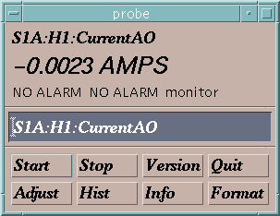
Channel Access in One Slide
“connection request” or “search request”
“get” or
“caGet”
“put” or
“caPut”
“set a monitor”
Who has a PV named “S1A:H1:CurrentAO”?
Change its value to 30.5
Notify me when the value changes
What is its value?
Channel Access Client
CA Client
CA Server
Channel Access Server
I do.
25.5 AMPS
OK, it is now 30.5
It is now 20.5 AMPS
It is now 10.5 AMPS
It is now -0.0023 AMPS
Process Variables:
S1A:H1:CurrentAO
S1:P1:x
S1:P1:y
S1:G1:vacuum
“put complete”
“post an event”
or
“post a monitor”
30.5 is too high. It is now set to the maximum value of 27.5.
or
You are not authorized to change this value
or

Slide 17
Multiple IOCs on Host
Host, IP 1.1.1.1
IOC
TCP 5064
IOC
TCP ???
IOCs on IP 1.1.1.1, net 1.1.1.0
  UDP 5064, TCP 5064
  UDP 5064, TCP ???
Try to reach from other subnet
  EPICS_CA_ADDR_LIST=1.1.1.1
    Won’t work!
    Quirk in network kernels:
    Only the IOC started LAST (FIRST on Windows)
    will get anything on UDP 5064
  EPICS_CA_ADDR_LIST=1.1.1.255
    OK. When using broadcast into subnet, all IOCs on UDP 5064 will see search requests.
UDP 5064
1.1.1.255
Outside client

Slide 18
Firewall?!
Host, IP 1.1.1.1
IOCs on IP 1.1.1.1, subnet 1.1.1.0
  UDP 5064, TCP 5064
  UDP 5064, TCP ???
  EPICS_CA_ADDR_LIST=1.1.1.255
Firewall cannot open unpredictable TCP ???
Likely to block broadcasts
Need to run CA Gateway:
  Firewall allows access to CAGateway
  CAGateway uses broadcast inside subnet
IOC
TCP 5064
IOC
TCP ???
Firewall:
Open UDP 5064,
TCP 5064 and ??
Outside client

Slide 19
Handling of Network Interruptions
No Network is up 100%, so CA was designed to handle this:
  TCP connection closed by server?
    Notify client code about problem
      Operator displays tend to indicate this.
    Client sends new search requests.
  No data nor beacon from server for 30 sec.?
    Client sends “Are you there?” query
    If no response for 5 sec, also notify client code, but TCP connection is kept open to avoid network storms.
    If server eventually sends data: OK. Otherwise, we're waiting until the OS cuts the TCP connection (~hours).

Slide 20
Beacons
Assume all is fine, we are connected, but the data simply doesn't change.
  How do we know the server is still OK?
Assume we searched for a PV, didn't get any response for ~8 minutes.
  How do we learn about a new CA server starting up which might have the missing PV? What triggers renewed search requests?

Slide 21
Beacons!
UDP broadcast packet sent by a CA Server
When it is healthy, each Server broadcasts a UDP beacon at regular intervals (like a heartbeat)
  EPICS_CA_BEACON_PERIOD, 15 s by default
When it is coming up, each Server broadcasts a startup sequence of UDP beacons
  Starts with a small interval (~2 ms)
  Interval doubles each time until reaching 15 sec
Clients monitor the beacons
  Receive beacons: Server is OK.
  Receive new beacons at changing intervals: Beacon “anomaly”, new CA server, restart searches.

Slide 22

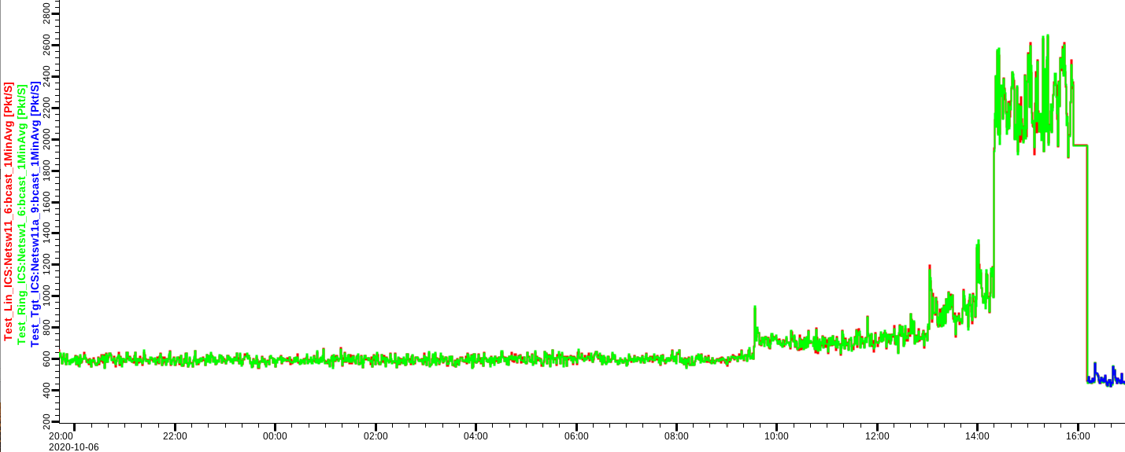
Beacon: Seemed like a good idea, but…
Archive setups may have many missing PVs
Overloaded IOCs or network delays may change beacon pattern
.. into this:
➔ Clients with disconnected channels re-start their searches!
Burst in network traffic

Slide 23
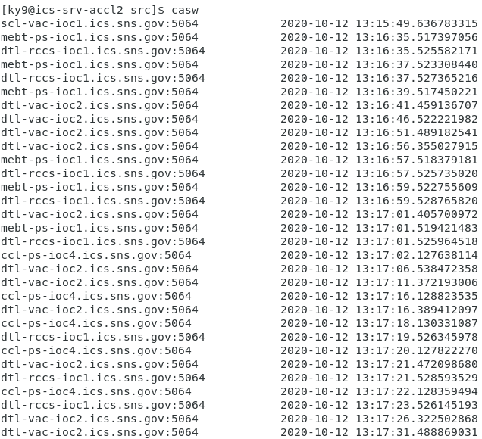
TODO: Monitor & Maintain CA Network
Check clients for disconnected channels
  Archive
  Displays
  Run “caSnooper” to spot such clients
Periodically run “casw”
  Lists “beacon anomalies”
  Are those CA servers indeed “new”?

Slide 24
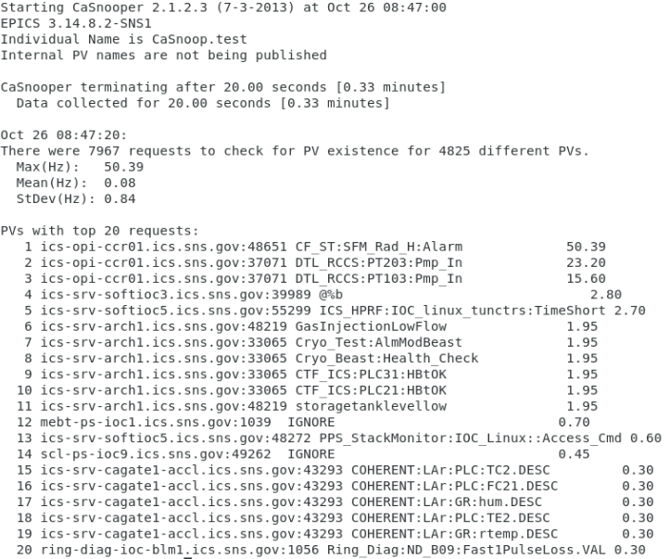
caSnooper
Example caSnooper –p20 –t20

Slide 25
caRepeater?
Older OSs didn't allow multiple programs to listen to the same UDP port
  They didn't see the beacons (UDP broadcasts)!
caRepeater solves this problem
  There is one caRepeater process per workstation
  Clients make a TCP connection to it when they start up
  caRepeater receives the beacons
    EPICS_CA_REPEATER_PORT[usually 5065]
  .. and forwards them to clients.
IOC1
Client Computer
Client
IOC2
CaRepeater
Client
IOC3
…

Slide 26
Issues
CA Client does not connect
  Check basic network connectivity.
    Can server and client machines 'ping' each other?
    Check EPICS_CA_ADDR_LIST if server is on different subnet.
CA Client does not re-connect after network issue or IOC reboot
  Use casw, wireshark: Does the client computer receive the (anomal) beacons of the rebooting IOC?
  Check EPICS_CAS_BEACON_ADDR_LIST,since routers will not forward beacons across subnets.
  Check if 'caRepeater' is running on the client.

Slide 27
What is a PV (Channel)?
Whenever there's a CA server out there which decides to respond to a search request, that's a PV!
iocCore responds to "{record}.{field}" searches if
  the {record} is for a record on this IOC,
  and the {field} is an accessible field of that record,
  or it's the pseudo-field "RTYP" (record type).
So every field of every record is a PV.
But you can implement your own CA server based on the CAS library (for C++), or the pcaspy wrapper for Python, and then you decide when to respond!

Slide 28
Channel Properties
Each channel comes with properties:
  Value
    of type string or double or int or …
    Scalar or array
  Time stamp
    Up to nanosecond precision
  Severity code
    OK, MINOR, MAJOR, or INVALID
  Status code to qualify the severity
    OK, READ error, WRITE error, at HIGH limit, …
  units, suggested display range, control limits, alarm limits.

Slide 29
Client interface to properties
The available properties are fixed.
  One cannot add a new 'color' property.
The request types are fixed.
  "DBR_…" types.
  Available:
    Just value.
    Value with status and severity.
    Value with status, severity and time stamp.
    "Everything:" value, units, time, status, limits, …
  Not available:
    Custom combinations like value with units.
  See `caget –h`

Slide 30
Records & Fields vs. Channels & Properties
A CA client asks for the properties of a channel.
The implementer of the CA server decides how to answer.
The iocCore implementation maps the fields of a record to the properties of a channel.
  Details are in the source code for the respective record type. Not always predictable or meaningful!

Slide 31
Example: AI record "fred"
PV "fred" or "fred.VAL"
  value property of channel = VAL field of record.
    Type double, one element (scalar).
  time property = TIME field
  status = STAT
  Severity = SEVR
  units = EGU
  Precision = PREC
  display limit low, high = LOPR, HOPR
  control limit low, high = LOPR, HOPR
  alarm limits = LOLO, LOW, HIGH, HIHI
Makes a lot of sense.
  GUI can display the value together with units, formatted according to the precision, as e.g. "12.37 volts”.

Slide 32
Example: AI record "fred"
PV "fred.SCAN"
  value property of channel = SCAN field of record.
    Type enumerated, values: "Passive", "1 second", ...
  time property = TIME field?
  status = STAT?
  Severity = SEVR?
  control limit low, high = 0, ??

Slide 33
When will ‘camonitor’ receive new value?
When the CA server (IOC) sends a new value!
  Analog records: VAL change >= MDEL
  Binary records: Every change
Assuming Client uses ‘DBE_VALUE’ subscription
  DBE_LOG
    Meant for archive systems. Analog record change >= ADEL
  DBE_ALARM
    Meant for alarm systems

Slide 34
Database Channel Access Link Flags
CA: Force CA link, even though target in same IOC
CP: For INP link, process on received CA monitor
CPP: CP, but only if SCAN=Passive
Allows for “process record if inputs change”

Slide 35
Points to remember
In 99% of the cases, CA "just works"
  If not, check EPICS_CA_ADDR_LIST
  If that's not it, there could be a subnet/router issue with UDP search broadcasts and beacons.
Channel/property and Record/field are different things!
  This decouples the CA clients from the IOC database and its record types, allowing EPICS collaborators to share CA client tools for vastly different records and databases.
  But also means that CA clients have no idea about records nor fields.
    Client can't know that there might be a "readback" AI that goes with a "setpoint" AO record.
    The archiver stores channels and their properties, not a whole AI or motor record.
    Important properties for dealing with waveform data is definitely missing (sample rate, type of data).

